Slide 1
Machine Learning Assignment 2
S10223485H – Tran Huy Minh

Slide 2

1. Introduction
ML for Classification & Regression:Predict categorical/continuous outcomes
Train on labeled data
Evaluate & fine-tune model performance
Algorithms: Logistic Regression, Decision Trees, Random Forest, etc

Slide 3

2. HR Analytics – Problem Understanding and Approaches
Identifying Promotable Employees:
Key challenge for HR departments
Improved retention, productivity, informed HR decisions
Problem Value:
Improves HR effectiveness
Focuses efforts on top performers
Informs hiring, training decisions
Benefits organization as a whole
ML Models:
Create models to predict employee promotion
Improved accuracy & efficiency with ML models

Slide 4
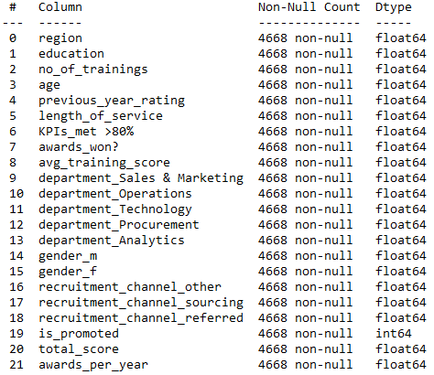
2. HR Analytics – Building the models
Loaded cleaned dataset from Assignment 1
Performed stratified sampling for balanced samples
Train test split with a ratio of 70% to 30%
Final shape of 6535 rows in X train and 2801 in X test

Slide 5
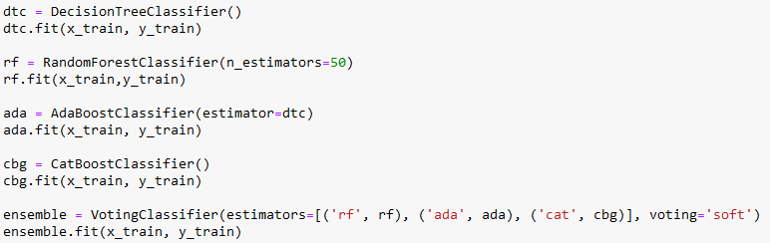
2. HR Analytics – Building the models
Created 5 baseline classification models
DecisionTreeClassifier
RandomForestClassifier
AdaBoost with DecisionTreeClassifier
CatBoostClassifier
SoftVotingClassifier using RandomForest, AdaBoost and CatBoost

Slide 6
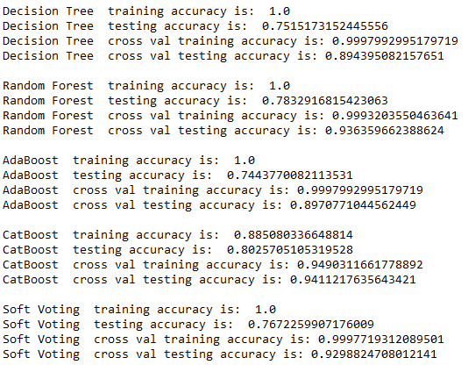
2. HR Analytics – Model Evaluation
The higher the test accuracy, the better the model
Utilized K-folds cross validation for overfitting detection
CatBoost model performs best
Although there is training accuracy of 100%, they do not perform well in predicting the target variable

Slide 7
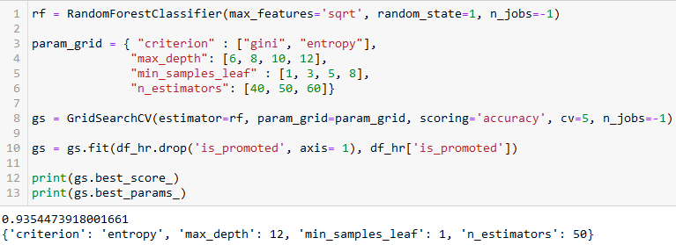
2. HR Analytics – Improving the models
Performed GridSearch on models with different hyperparameters
Determines best parameters for high accuracy

Slide 8
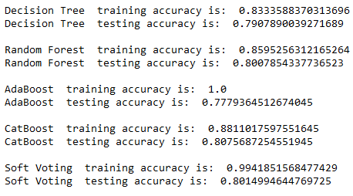
2. HR Analytics – Evaluating Improved Models
Original Model Accuracy
Improved Model Accuracy

Slide 9
2. HR Analytics – Summary
Out of all 5 improved models
CatBoostClassifier has the highest test accuracy
Best model in predicting whether or not an employee is promoted

Slide 10

3. Airbnb – Problem Understanding and Approaches
Airbnb Rental Price Prediction:
Significant value for hosts and guests
Utilizes listings.csv dataset
Regression model to predict daily rental price
Benefits:
Optimize revenue for hosts
Help guests plan & budget
Improved decision making for both parties
Informed Airbnb experiences

Slide 11
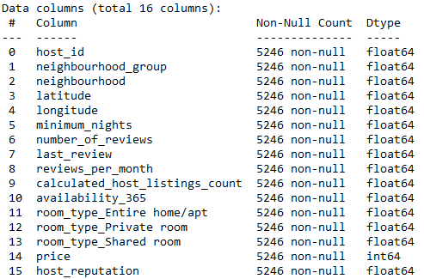
3. Airbnb – Building the Models
Loaded cleaned dataset from Assignment 1
Used ‘price’ as target variable
Train test split with a ratio of 70% to 30%
Final shape of 3672 rows in X train and 1574 in X test

Slide 12
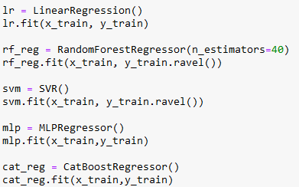
3. Airbnb – Building the Models
Created 5 baseline regression models
LinearRegression
RandomForestRegressor
Support Vector Machine Regressor
MLPRegressor (ANN)
CatBoostRegressor

Slide 13
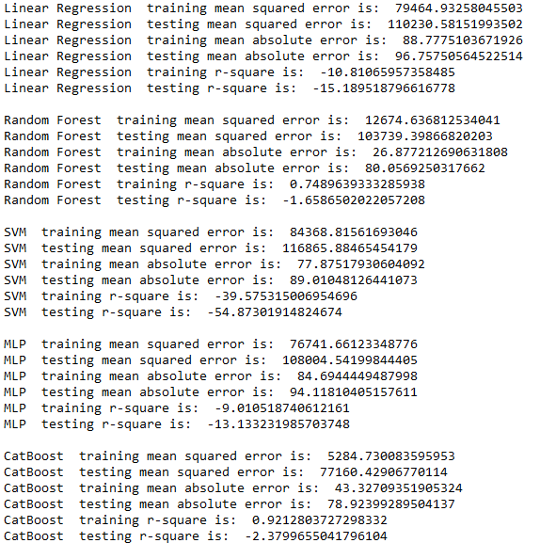
3. Airbnb – Model Evaluation
The lower the MAE and MSE is, the better the model
The closer the r-square is to 1, the better the model
R-square is a measure of the goodness of fit of a model
Since R-square is negative, it means all the models are a poor fit for tha data

Slide 14
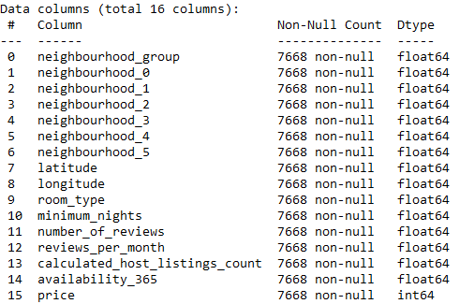
3. Airbnb – Improving the models
Recleaned the original AirBNB listings dataset
Performed many similar cleaning techniques
Notable changes –
Removing and replacing outliers for price, latitude and longitude
Mapped integers for room types
Used binary encoding for neighbourhood
Used label encoding for neighbourhood_group
Removed last_review

Slide 15
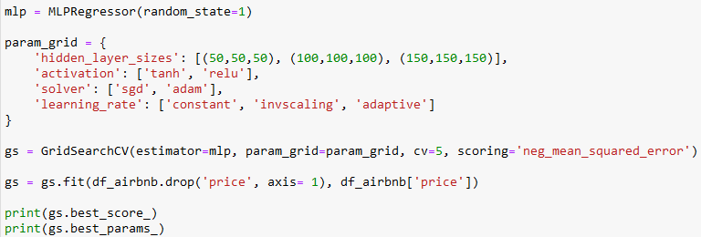
3. Airbnb – Improving the models
Performed GridSearch on models with different hyperparameters
Determines best parameters for lowest negative mean squared error

Slide 16
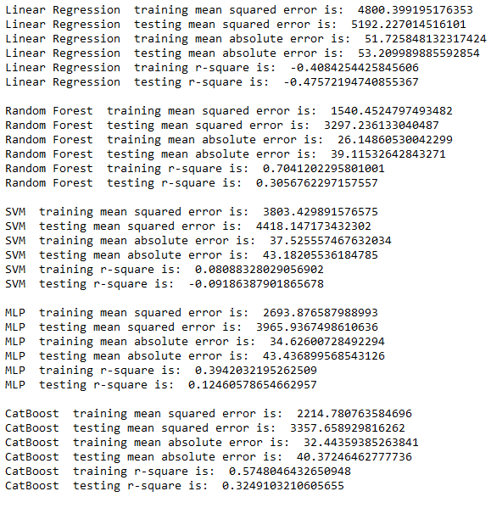
3. Airbnb – Evaluating the improved models
Original Model Accuracy
Improved Model Accuracy

Slide 17
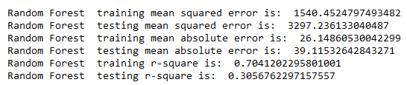
3. Airbnb – Summary
Out of all 5 improved models
Random Forest Regressor has the lowest MSE, MAE
Has slightly lower r-square than CatBoost but still acceptable
Best model in predicting Airbnb price

Slide 18
4. Conclusion
HR Analytics Dataset from Assignment 1:
Cleaned and usable for model building
Best Model for Employee Promotion Prediction:
CatBoostClassifier
Accuracy: 80.7%
Airbnb Dataset from Assignment 1:
Ineffective for model building dictated by r-square
Changes were made and the dataset was cleaned again
Best Model for Airbnb Price Prediction:
Random Forest Regressor
Low MSE: 3297
Low MAE: 39

Slide 19
5. Reflection
Possible further improvements:
More models could be created for better comparison
Improvements can be made to current model performances through tuning more hyperparameters, selecting different input features, further adjusting input data, etc
Skills learnt:
Learned how to develop and build various supervised machine learning models to solve classification and regression problems
Implementation of fine tuning techniques to enhance the performance of machine learning models built
Could have learnt to understand why certain models and fine tuning techniques are more desirable than others better

